Slide 1
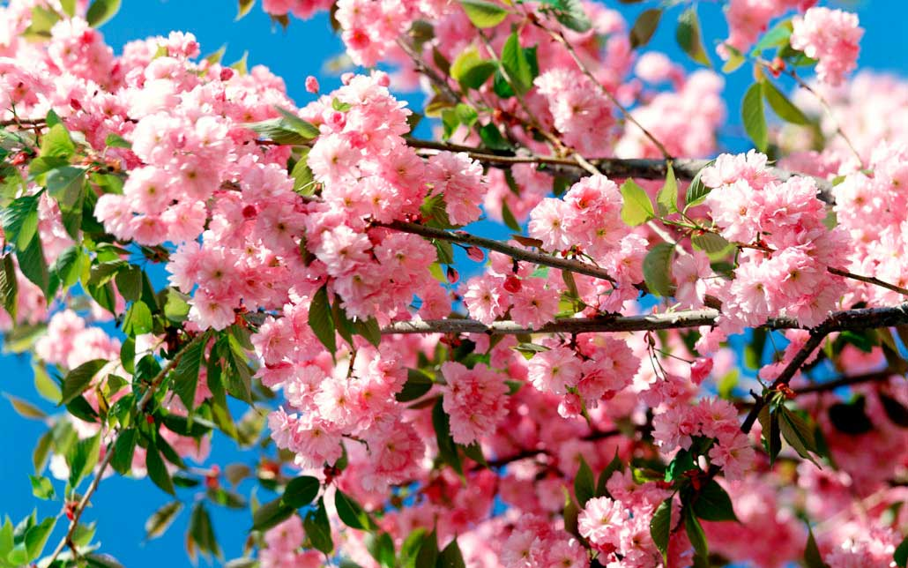
Writing skills.
We learn to describe places.
Lesson 89, form 11
“Spotlight”
Prepared by Kanunnikova N.A.

Slide 2
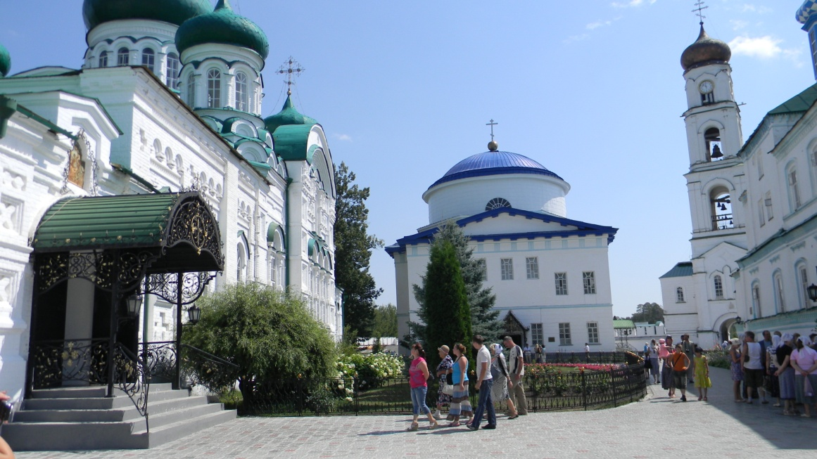
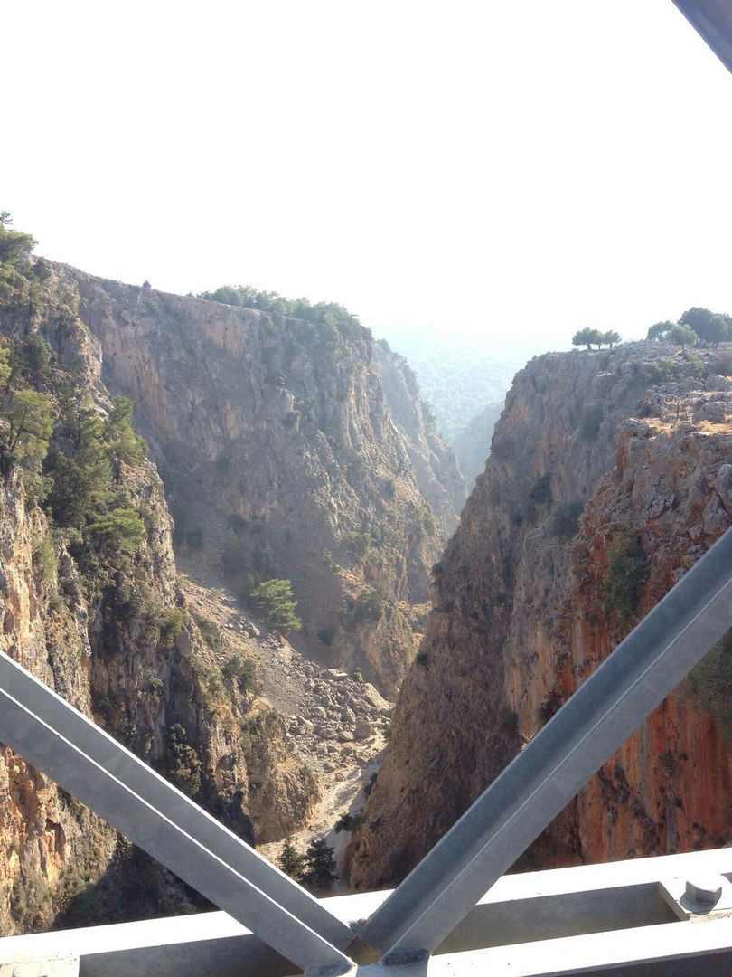
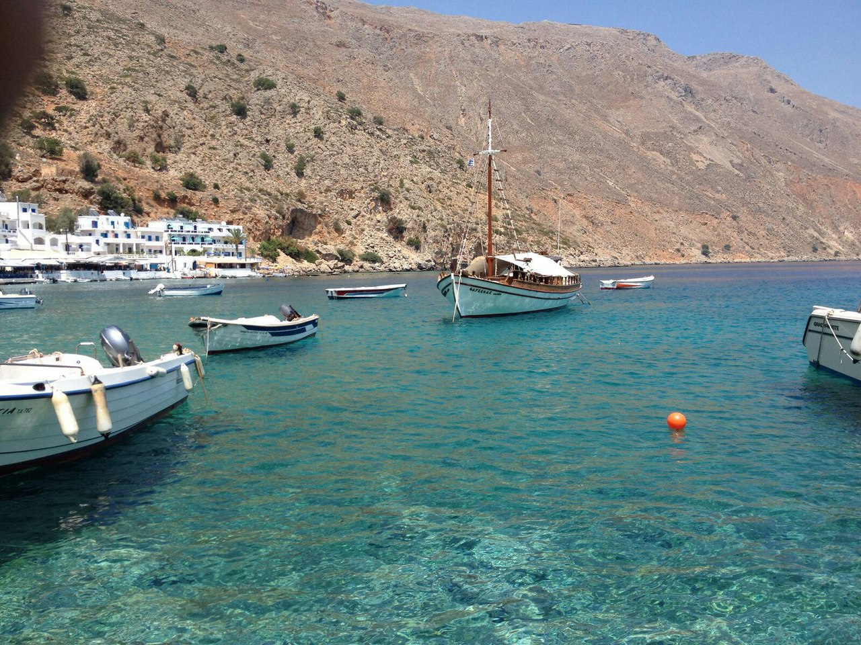

Slide 3

Match the beginning and the end of the word expressions and translate them.
hail | of wind
gust | of sunshine
drop | of thunder
ray | stone
Bolt | flake
clap | of rain
snow | of lightning

Slide 4
The order of adjectives
Size | Age/temperature | Shape | Colour | Origin | Material | Noun
big | Old/hot | round | grey | Scottish | stone | cottage

Slide 5
Answer Key
1 spectacular ancient stone statues
2 beautiful long hot summer
3 wide stony path
4 cute little wooden huts
5 huge brightly-coloured fields
6 wonderful old French bakery

Slide 6
Answer Key
1 extremely
2 lazily
3 happily
4 noisily
5 patiently
1 smoothly
2 incredibly
3 leisurely
4 deafeningly
5 enthusiastically

Slide 7

Home task
Do ex. 13 p. 148 in written fo
rm.

